Slide 1
Paper Review
2022-08-25
Gyurin Byun
Sungkyunkwan University
byungyurin21@g.skku.edu

Slide 2
Presentation Outline
Increases in Naloxone Administrations by Emergency Medical Services Providers During the COVID-19 Pandemic: Retrospective Time Series Study
New Measures of the COVID-19 Pandemic: A New Time-Series Dataset

Slide 3
Increases in Naloxone Administrations by Emergency Medical Services Providers During the COVID-19 Pandemic: Retrospective Time Series Study
Introduction
This study examines changes in the occurrence of naloxone administrations and multiple naloxone administrations during EMS runs for opioid-related overdoses during the COVID-19 pandemic in Guilford County, North Carolina (NC)
The number of opioid overdose deaths increased
(47 in 2015, 71 in 2016, 98 in 2017, 96 in 2018, and 108 in 2019)
Using a period-over-period approach, during the 29-week period before (September 1, 2019, to March 9, 2020)
Opioid overdose–related EMS runs
Naloxone administrations during opioid overdose–related EMS runs
Multiple naloxone administrations during opioid overdose–related EMS runs

Slide 4
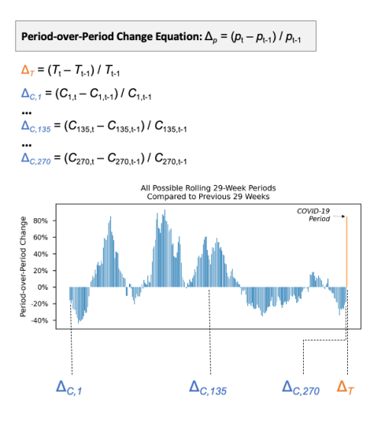
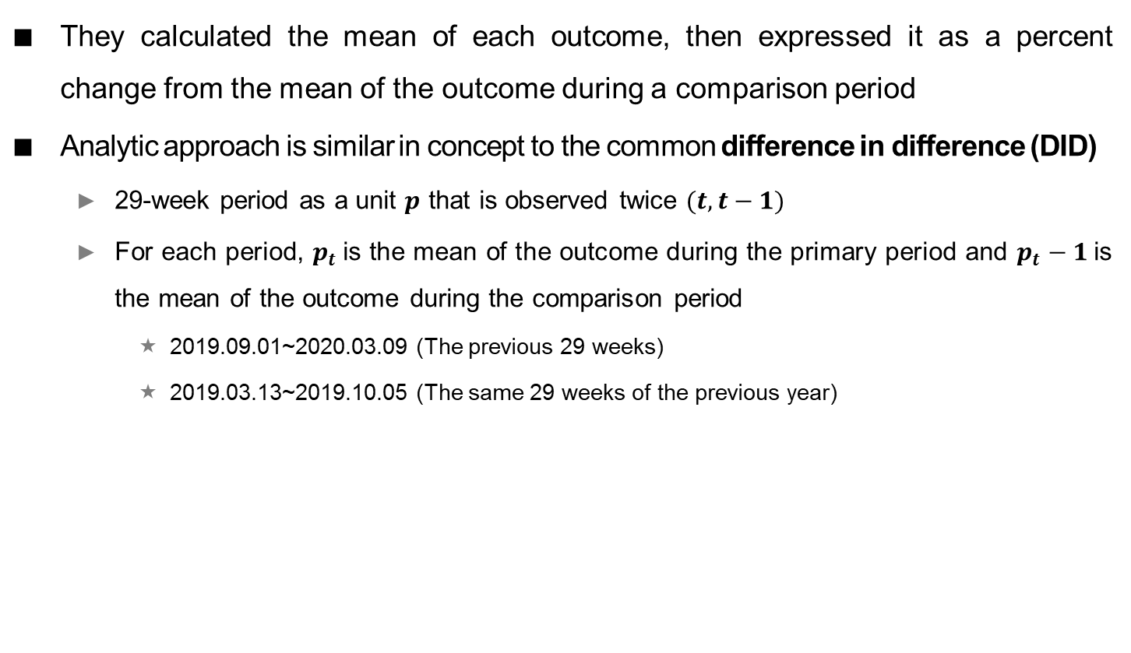
Increases in Naloxone Administrations by Emergency Medical Services Providers During the COVID-19 Pandemic: Retrospective Time Series Study
They calculated the mean of each outcome, then expressed it as a percent change from the mean of the outcome during a comparison period
Analytic approach is similar in concept to the common difference in difference (DID)
29-week period as a unit $p$ that is observed twice $(t, t−1)$
For each period, $p_{t}$is the mean of the outcome during the primary period and $p_{t}−1$is the mean of the outcome during the comparison period
2019.09.01~2020.03.09 (The previous 29 weeks)
2019.03.13~2019.10.05 (The same 29 weeks of the previous year)

Slide 5
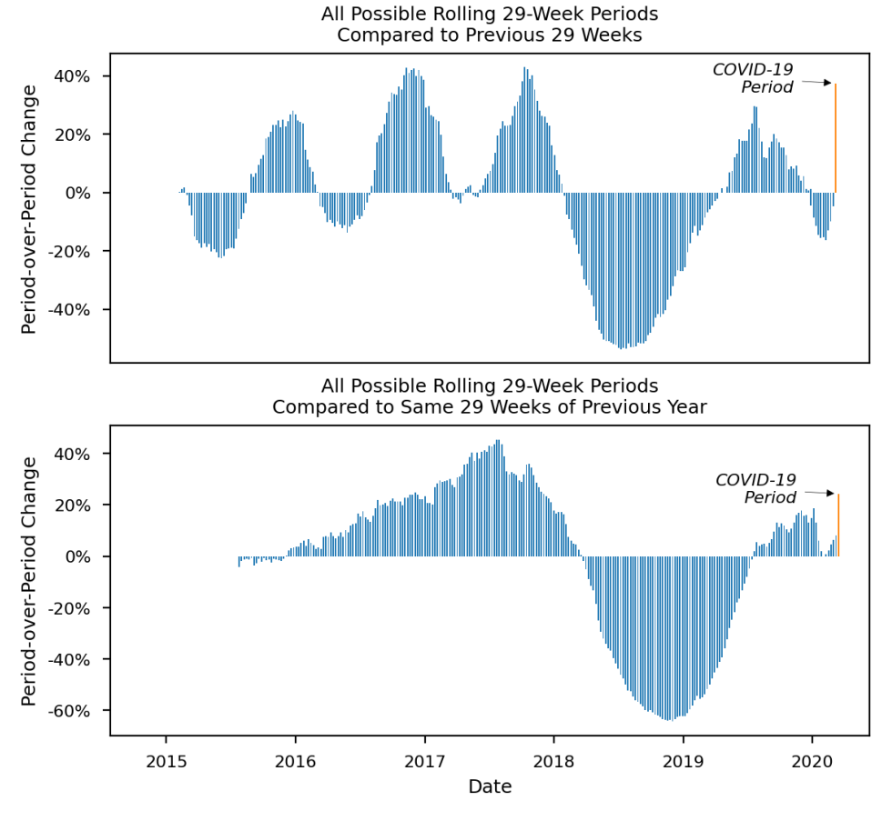
Increases in Naloxone Administrations by Emergency Medical Services Providers During the COVID-19 Pandemic: Retrospective Time Series Study
X-axis represents time from the first possible comparison period (2015.02.08) since the beginning of the data set (2014.01.01) to the end of the COVID-19 period (2020.09.30)
Y-axis represents the percent change in each period relative to its comparison period
The furthest right bar (in orange) shows the outcome during the COVID-19 period
Opioid overdose–related EMS runs

Slide 6
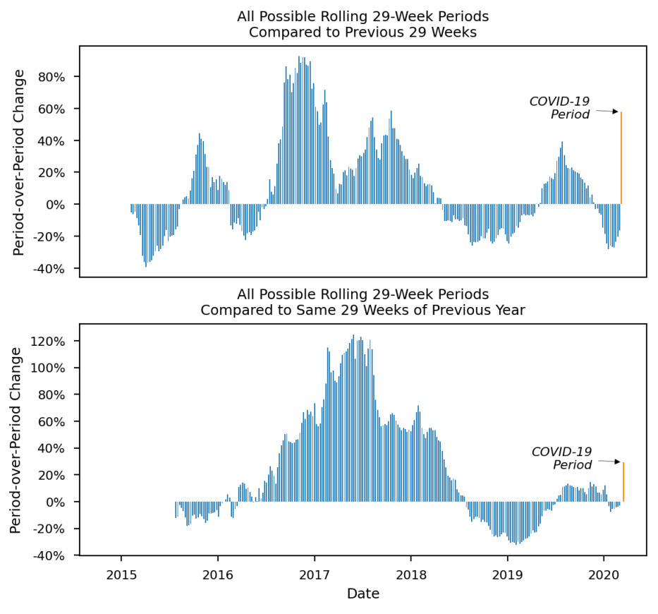
Increases in Naloxone Administrations by Emergency Medical Services Providers During the COVID-19 Pandemic: Retrospective Time Series Study
X-axis represents time from the first possible comparison period (2015.02.08) since the beginning of the data set (2014.01.01) to the end of the COVID-19 period (2020.09.30)
Y-axis represents the percent change in each period relative to its comparison period
The furthest right bar (in orange) shows the outcome during the COVID-19 period
Naloxone administrations

Slide 7
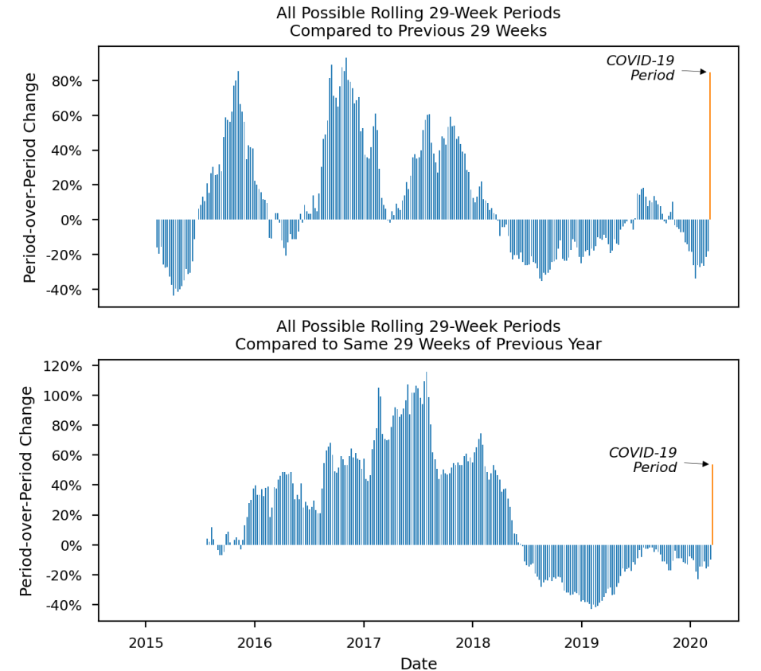
Increases in Naloxone Administrations by Emergency Medical Services Providers During the COVID-19 Pandemic: Retrospective Time Series Study
X-axis represents time from the first possible comparison period (2015.02.08) since the beginning of the data set (2014.01.01) to the end of the COVID-19 period (2020.09.30)
Y-axis represents the percent change in each period relative to its comparison period
The furthest right bar (in orange) shows the outcome during the COVID-19 period
multiple naloxone administrations

Slide 8
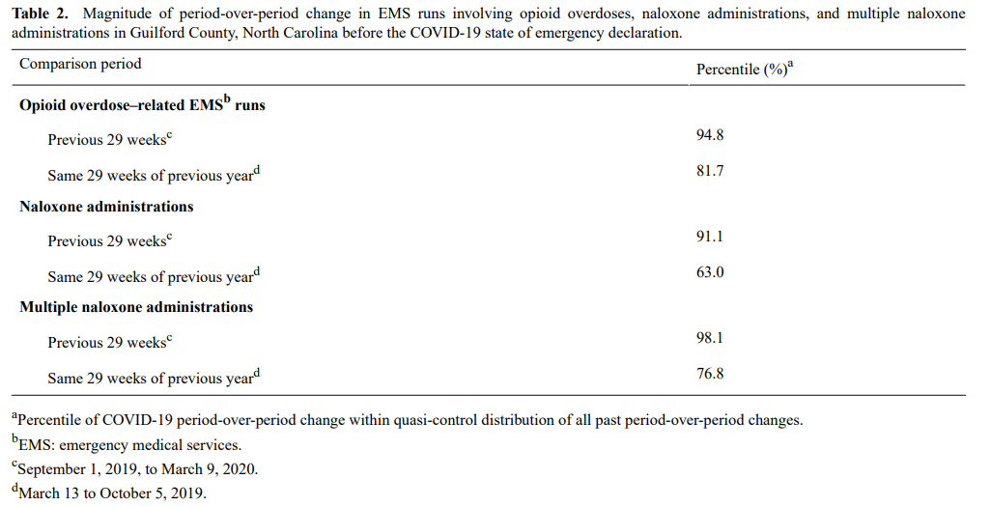
Increases in Naloxone Administrations by Emergency Medical Services Providers During the COVID-19 Pandemic: Retrospective Time Series Study
Conclusion
All three outcomes increased sharply and significantly during the COVID-19 period
COVID-19 pandemic appears to have exacerbated the opioid crisis
Notes:
아편유사제 과다복용, 날록손 투여 및 다중 날록손과 관련된 EMS 실행의 기간별 변화의 크기

Slide 9
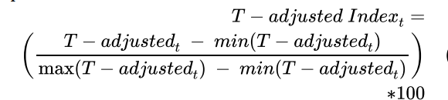
New Measures of the COVID-19 Pandemic: A New Time-Series Dataset
Introduction
In this paper, a total of 327 keywords related to various aspects of COVID-19 are proposed using data from all articles on the COVID-19 pandemic in 45 most popular newspapers worldwide
They construct six different indices relating to the COVID-19 pandemic
COVID , medical, vaccine index, travel, uncertainty, aggregate COVID-19 sentiment
Index construction
2019.12.31~2021.04.28 (ProQuest database)
They count the number of times each word in our dictionary appears in these publications’ daily articles
Ordinary Least Squares (OLS) regression

